Slide 1
eTRAKiT http://etrakit.cstx.gov/etrakit3/
The City of College Station now has an online system for submitting Permits, Projects and applying for Licenses.
With this new system, you can apply for Permits (commercial/residential building permits, irrigation permits, electrical/mechanical/plumbing permits etc.), Projects (Site Plans, Final Plats, Preliminary Plans, Development Permits etc.) and Licenses (Rental Registration), pay any applicable fees, request inspections, view status, submit drawings and supporting documentation and view staff comments and reviews.
To submit permits and/or projects through this system, please submit the information on the last page of this handout so that we may set you up as a contractor in our system. Please note, this can only be done by a City employee. The information can be turned in to our office or emailed to cspds@cstx.gov .

Slide 2
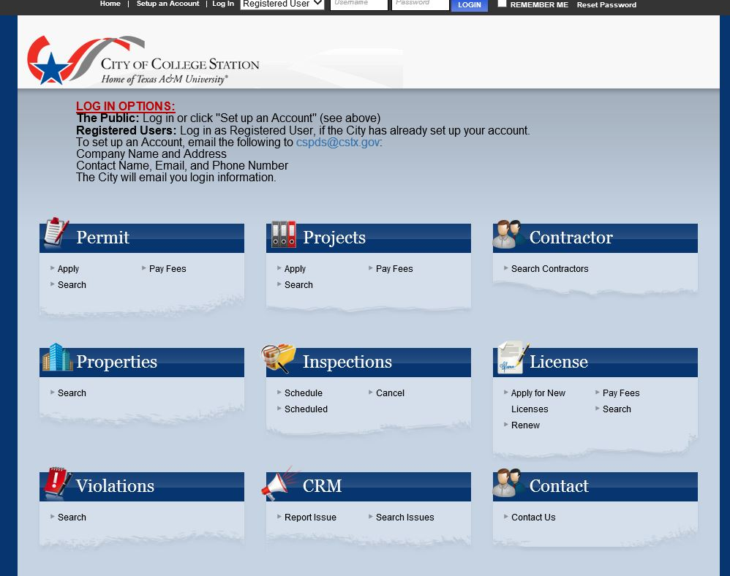
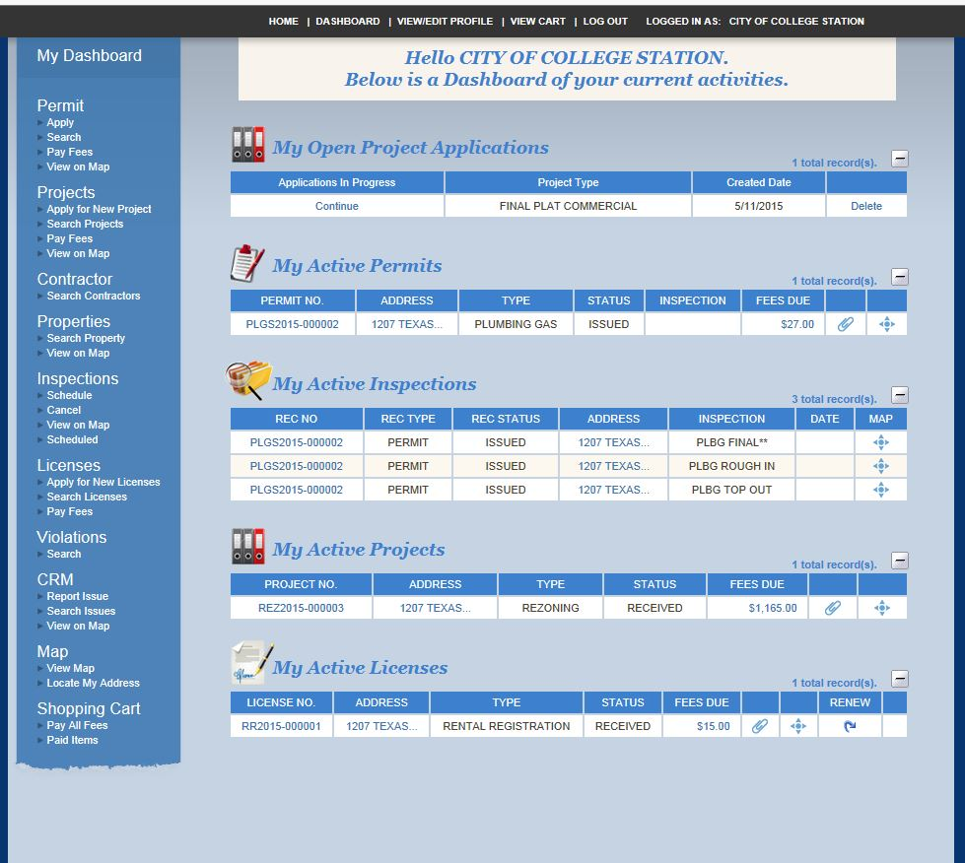
To begin the permit/project online process, please visit the eTRAKiT home page at http://etrakit.cstx.gov/etrakit3/.
You must select “Registered User” from the drop down box at the top and log in with the City provided User Name and Temporary Password.
Once you have logged in for the first time, the system will require you to create your own security question and change your password.
The system will then default to your Dashboard of current activities.
Your Dashboard will contain record of all permits, projects and/or licenses associated with your account.
The Dashboard will also be where you will apply for permits, projects and/or licenses using the left side options.

Slide 3
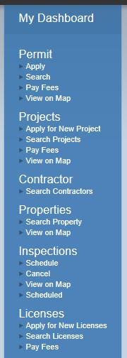
Applying for a New Permit/Project/License
To apply for a new Permit, click on Apply under the Permit section on the left side of your Dashboard.
To apply for a new Project, click on Apply for New Project under the Projects section on the left side of your Dashboard.
To apply for a new License, click on Apply for New Licenses under the Licenses section on the left side of your Dashboard.

Slide 4
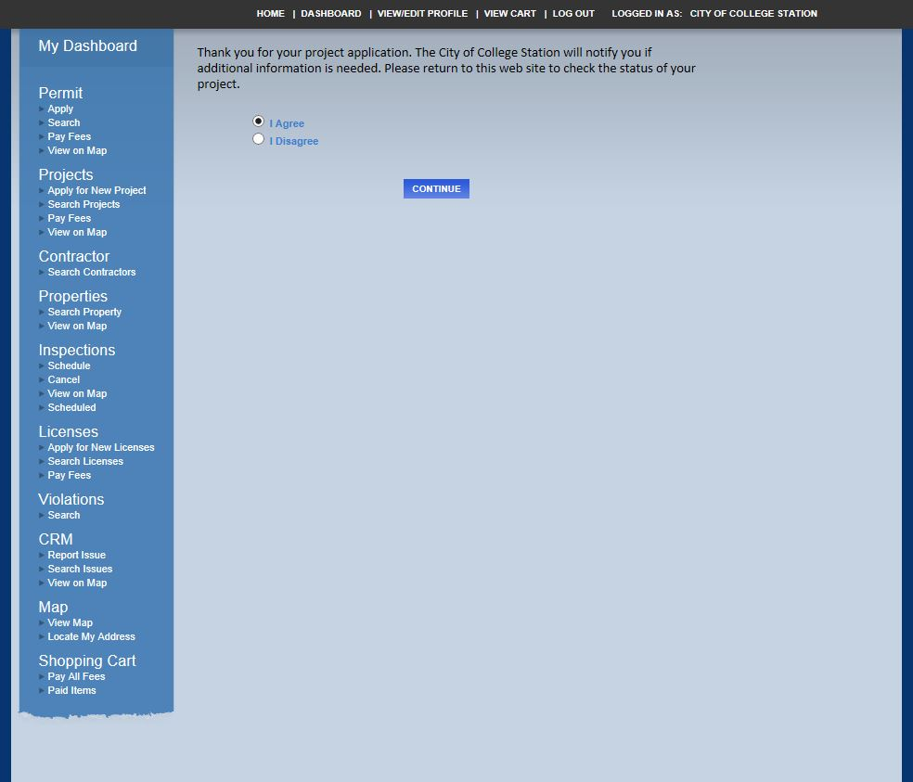
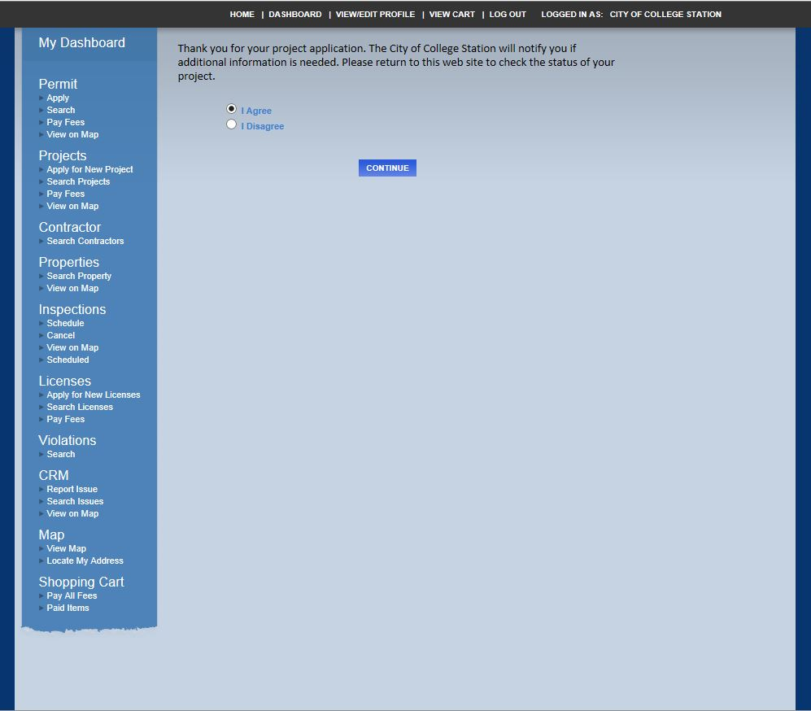
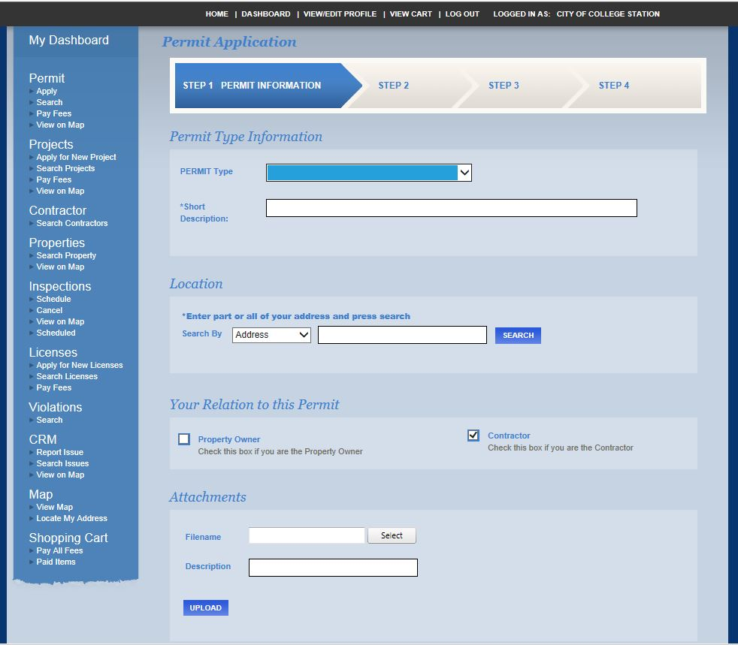
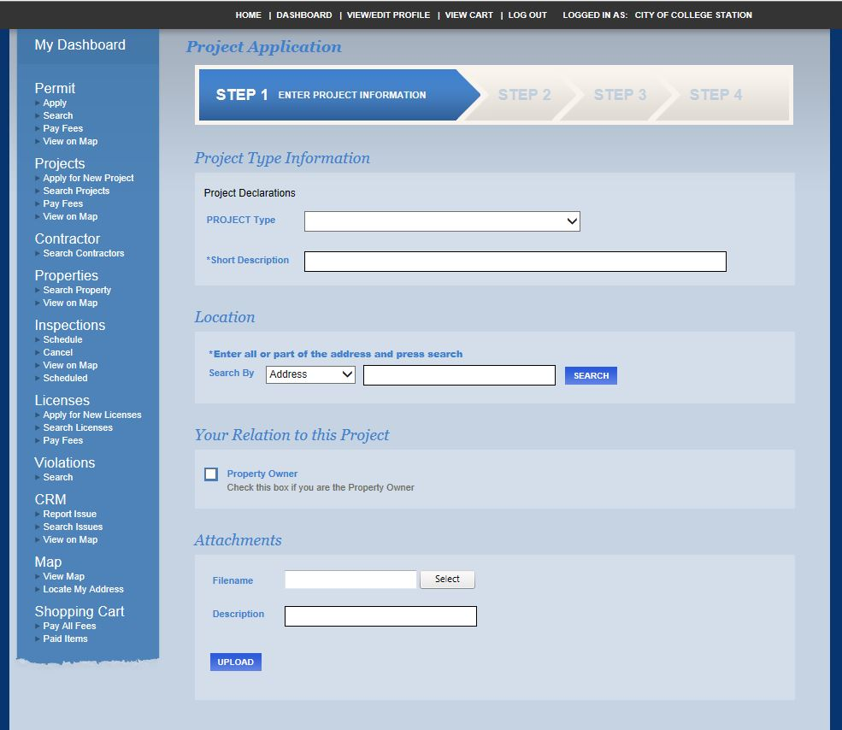
The system will require that you Agree to the disclaimer on this page before proceeding with a Permit or Project application. You will then click Continue.
The system will then move you through our Four Step Application Process to apply for your Permit or Project.
The screen will populate the required information based upon the Project Type or Permit Type selected on Step 1.

Slide 5
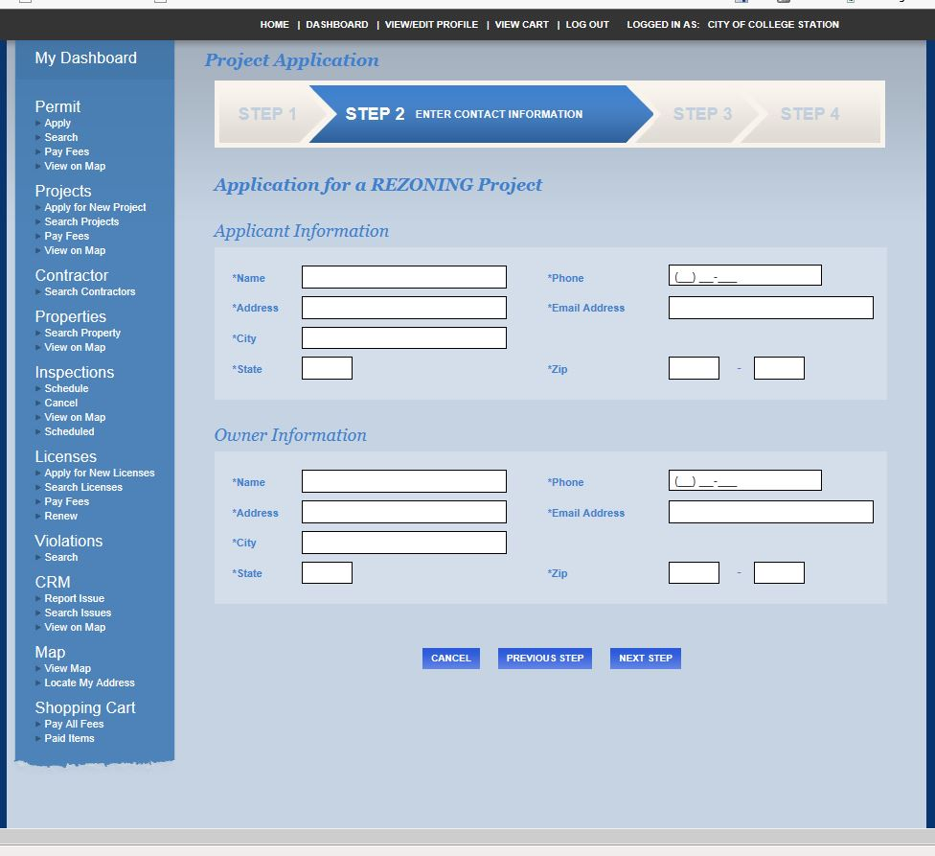
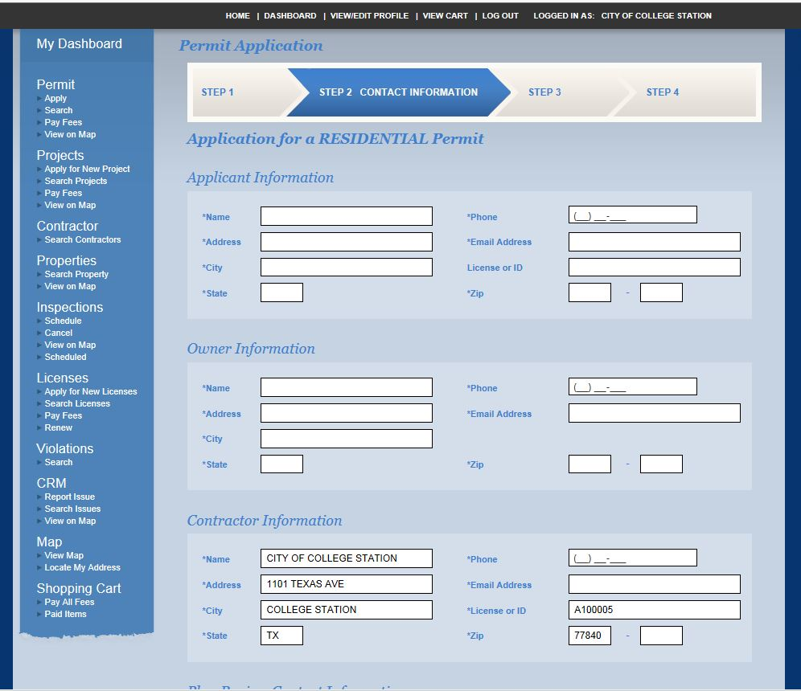
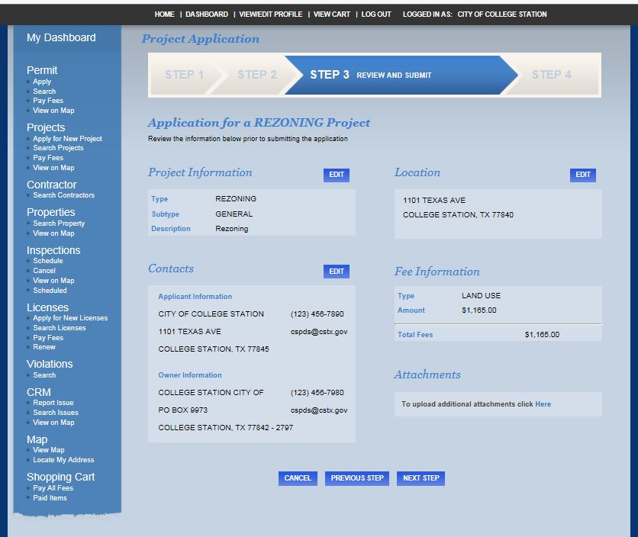
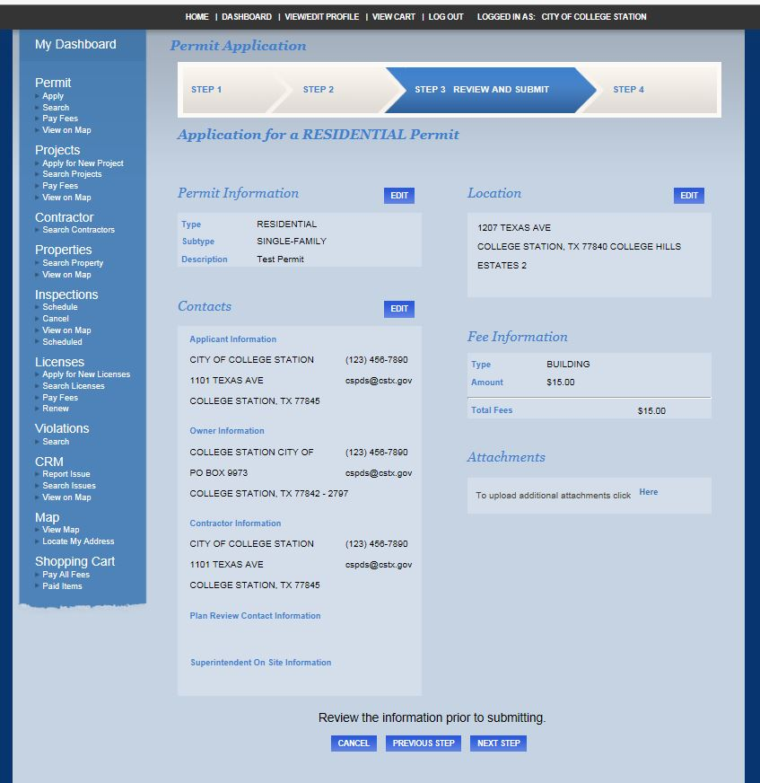
Once all required information is completed on Step 1, the system will allow you to proceed to Step 2.
Please make sure you attach any supporting documentation or drawings in the Attachments section at the bottom of the page on Step 1.
Step 2, Contact Information will require that contact information for the Applicant and Owner be populated. Contractor Information will automatically be populated for Permits based on your log in credentials and account/business information.
Step 3 will provide an entire over view of Steps 1 and 2 for revision.
Fee Information will provide the total of all fees due for the permit or the project.
  Please note, all Project submittals will require payment before the project is reviewed. Permit submittals will be turned into a City reviewer and fees will be due at the time the permit is approved and issued.

Slide 6
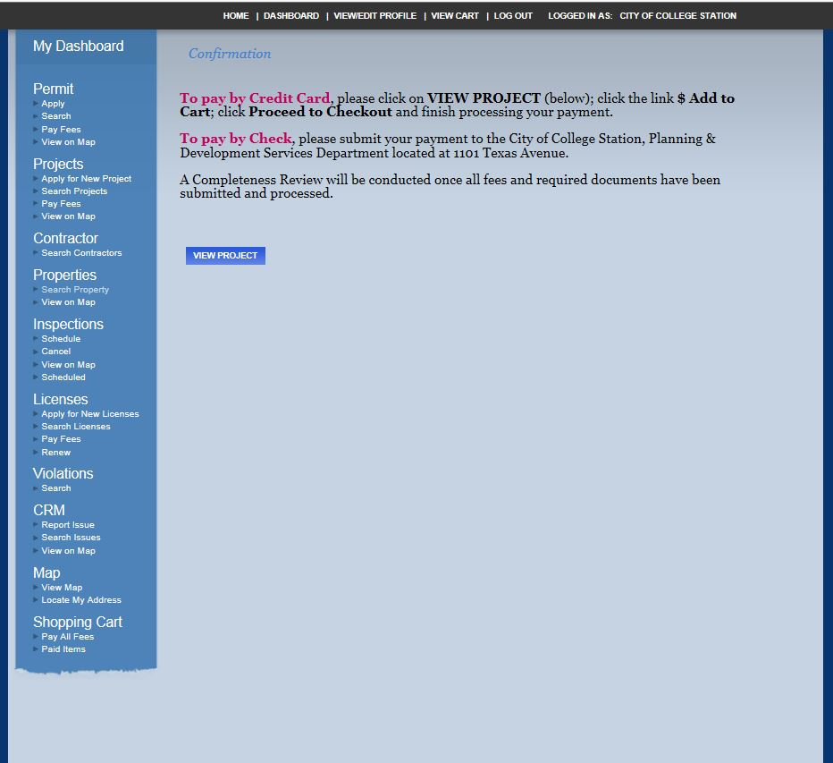
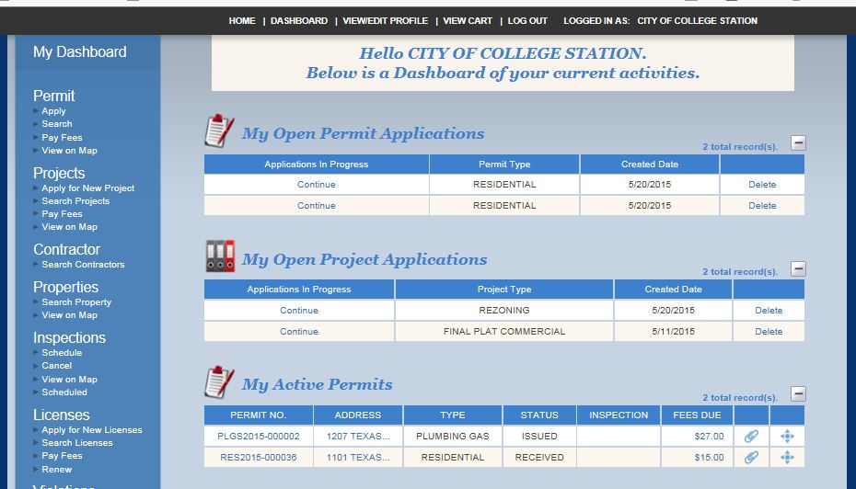
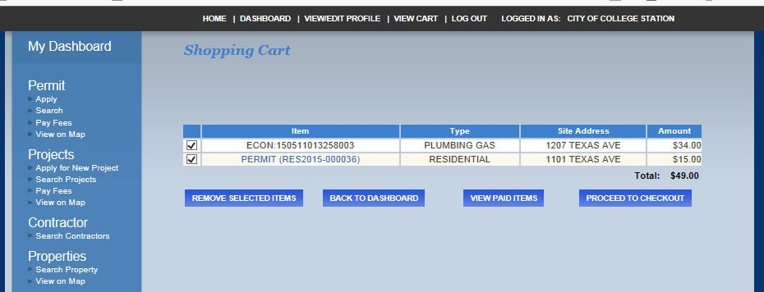
Payment Information
Project submittals can be paid online through our eTRAKiT system, or a check can be provided after the application process in order to begin the review process.
Permit submittal will require a payment once the permit has been approved. You will receive an email when the permit has been approved prompting you to visit your Dashboard and pay the fees by clicking on the Fee link. The link will take you to your shopping cart, pulling in any fees you may have due for payment.

Slide 7
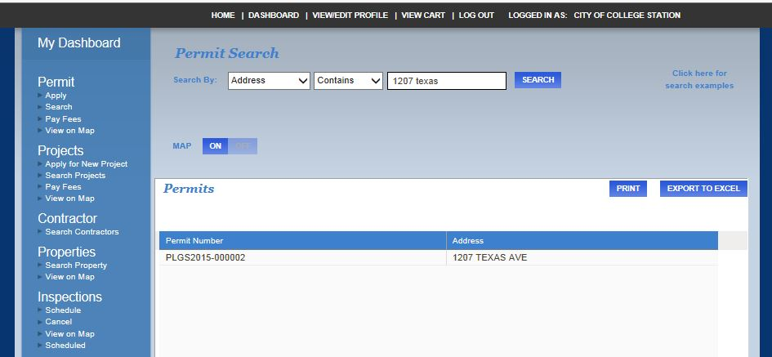
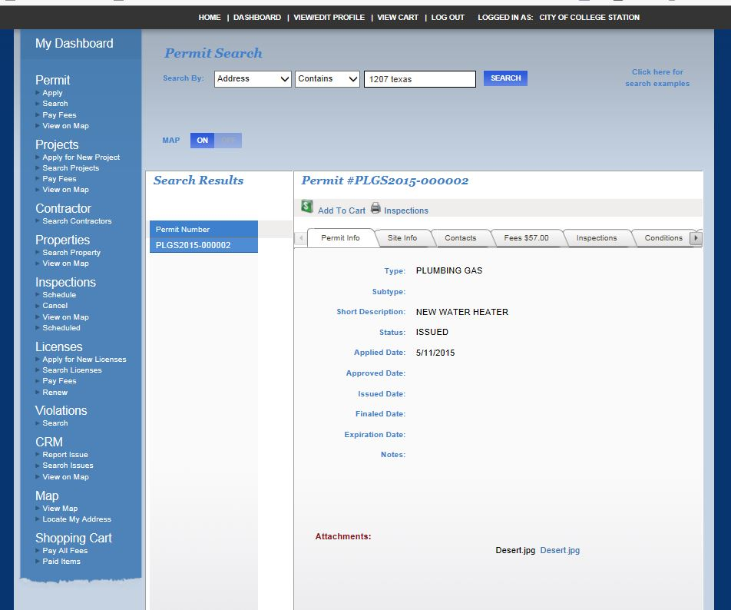
Your Permits & projects can also be searched for using the Search option under Permit or the Search Projects under Projects.
By typing in the searchable information next to Search By, a list will populate below with your options to choose from.
By clicking on the permit or project you are interested in, you will be able to see all information regarding this record such as Permit Info, Site Info, Contacts, Fees, Inspections, Conditions, Attachments and Reviews.
You are also able to request inspections on permits and view the results/notes on any active inspections.

